Slide 1
In vector space retrieval each row of the matrix M corresponds to
A document
A concept
A query
A term
Notes:
Answer D
M is an mxn matrix, with m rows corresponding to the m terms in the vocabulary.

Slide 2
Applying SVD to a term-document matrix M. Each concept is represented in K
as a singular value
as a linear combination of terms of the vocabulary
as a linear combination of documents in the document collection
as a least squares approximation of the matrix M
Notes:
Answer B
K is mxr matrix, where the columns correspond to vectors. These vectors correspond to a linear combination of the m terms of the vocabulary.

Slide 3
The number of term vectors in the matrix K_{s} used for LSI
Is smaller than the number of rows in the matrix M
Is the same as the number of rows in the matrix M
Is larger than the number of rows in the matrix M
Notes:
Answer B
K_s is a mxs matrix, where each row corresponds to a term in the vocabulary, as for M. The number of columns s is smaller than the number of columns in the original matrix K.

Slide 4
A query transformed into the concept space for LSI has …
s components (number of singular values)
m components (size of vocabulary)
n components (number of documents)
Notes:
Answer A
The transformed query is a vector over the number of selected concepts s.

Slide 5

Question
A row of matrix $W^{(c)}$ represents
How relevant each word is for a dimension
How often a context word $c$ co-occurs with all words
A representation of word $c$ in concept space
Notes:
Answer 1
The rows of the matrix correspond to the dimensions of the embedding. Each entry in the row corresponds to a word from the vocabulary. Therefore the row represents the importance of each word for a given dimension.

Slide 6
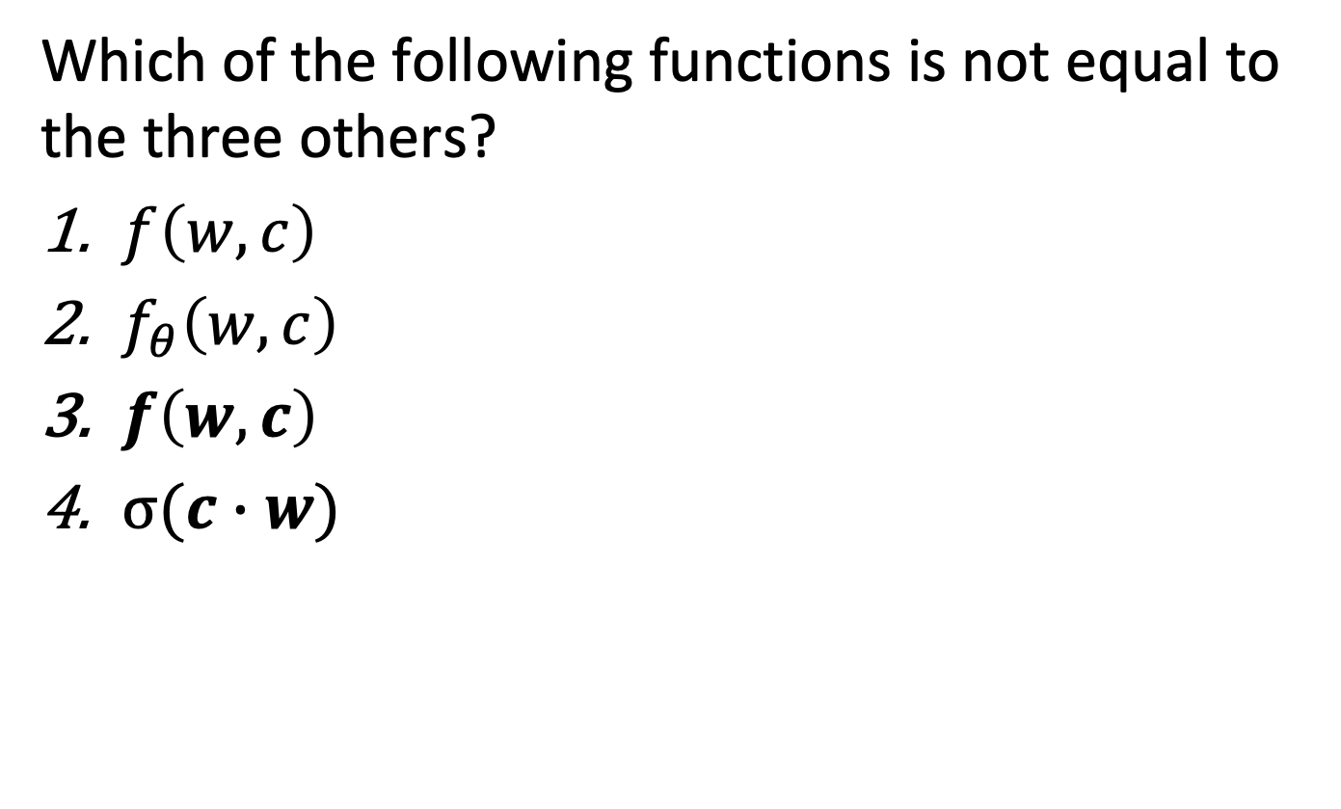
Question
Which of the following functions is not equal to the three others?
$f\left(w,c\right)$
$f_{θ}\left(w,c\right)$
$f\left(w,c\right)$
$σ(c∙w)$
Notes:
Answer 1
$f\left(w,c\right)$ is the function to be approximated. The three other functions are the same, with a more detailed specification for answers 2, 3 and 4.

Slide 7
Question
From which data samples the embeddings are learnt?
Known embeddings for (w,c) pairs
Frequency of occurrences of (w,c) pairs in the document collection
Approximate probabilities of occurrences of (w,c) pairs
Presence or absence of (w,c) pairs in the document collection
Notes:
Answer 4
In the skipgram model the sample data consists of word-context pairs that are present or absent in the document collection.

Slide 8
Question
With negative sampling a set of negative samples is created for
For each word of the vocabulary
For each word-context pair
For each occurrence of a word in the text
For each occurrence of a word-context pair in the text
Notes:
Answer 4
For each occurrence of a word-context pair, a set of negative samples is produced. Note that this is also different from creating a set of negative samples for each word-context pair, since the same word-context pair can occur multiple times in the document collection.

Slide 9
Question
The loss function is minimized
By modifying the word embedding vectors
By changing the sampling strategy for negative samples
By carefully choosing the positive samples
By sampling non-frequent word-context pairs more frequently
Notes:
Answer 1
The loss function is minimized by incrementally modifying the word embedding vectors. Answer 4 refers to an approach to improve the quality of the word embeddings achieved, but not to minimize the loss function.

Slide 10
Question
A word embedding for given corpus …
depends only on the dimension d
depends on the dimension d and number of iterations in gradient descent
depends on the dimension d, number of iterations and chosen negative samples
there are further factors on which it depends
Notes:
Answer 4
Other factors that can influence the outcome of the optimization are
The order in which the documents are processed
The initialization of the word embedding vectors

Slide 11
Question
Fasttext speeds up learning by
Considering subwords of words
By selecting the most frequent phrases in the text as tokens
By selecting the most frequent subwords in the text as tokens
By pre-computing frequencies of n-grams
Notes:
Answer 3
Answer 1 improves the quality of embeddings, but may slow down learning. Answer 4 speeds up the selection of frequent phrases, but not learning.

Slide 12
Question
The most important difference between Glove and skipgram is
That Glove considers the complete context of a word
That Glove computes a global frequency for word-context pair occurrences
That Glove uses a squared error loss function
That Glove does not differentiate words and context words
Notes:
Answer 2
The main difference between Glove and earlier methods, including skipgram and CBOW, is the computation of global co-occurrence counts. This is an additional processing step, but provides additional information on the global statistics. Answer 3 refers to a difference that is rather a consequence of using a global statistics. As for answer 4, in a sense also skipgram does not really distinguish between words and context words.

